Slide 1
gsk.com
Our purpose
We unite science, technology and talent to get ahead of disease together
for health impact + shareholder returns + thriving people
Our strategy
We prevent and treat disease with vaccines, specialty and general medicines.
We focus on science of the immune system, human genetics, and advanced
technologies, investing in 4 core therapeutic
areas and future opportunities to impact
health at scale.
We operate responsibly for all our
stakeholders by prioritising Innovation,
Performance and Trust.
Our culture
Ambitious for patients
to deliver what matters better and faster
Accountable for impact
with clear ownership and support
to succeed
Do the right thing
with integrity and care because people
count on us

Slide 2
Why GSK
Uniting science, talent, and technology to get ahead of disease together
Our success absolutely depends on our people. While getting ahead of disease together is about our ambition for patients and shareholders, it’s also about our ambition for GSK to be a place where people can thrive. We want GSK to be a place where people feel inspired, encouraged and challenged to be the best they can be. A place where people can be themselves – feeling welcome, valued and included. Where they can keep growing and look after their wellbeing. So, if you share our ambition, join us at this exciting moment in our journey to get Ahead Together.
We want GSK to be a workplace where everyone can feel a sense of belonging and thrive. We’re committed to being more proactive at all levels so that our workforce reflects the communities we work and hire in, and our GSK leadership reflects our GSK workforce.

Slide 3
Who are GSK
We make a wide range of prescription medicines, vaccines and consumer healthcare products

Slide 4
Commercial
We have a broad portfolio of innovative and established medicines, which generated sales of £17 billion in 2020, that treat everything from COPD to lupus and urology, as well as more than 20 different vaccines, with revenues of over £7 billion, that help protect people at all stages of life in over 160 countries. We are a global leader in respiratory disease and HIV, and we’re developing our presence in specialty therapy areas, including oncology and immuno-inflammation. Our focus is to deliver better and faster for patients globally.
Find out more:
Annual Report 2020
Product Pipeline

Slide 5
Vaccines
We are one of the world’s largest vaccines companies. Our portfolio of more than 20 vaccines helps protect people from a range of diseases throughout their lives, including pneumococcal disease, meningitis, hepatitis, rotavirus, whooping cough, and influenza in over 160 countries.
The vaccines in our portfolio have been helping protect people from serious disease for over 100 years and today generate sales of £7 billion (2020). Our strategy is to bring differentiated and high-quality vaccines to as many people as possible. To achieve this, we focus on creating a strong patient and payer-focused pipeline, maintaining valuable partnerships in the countries where we operate, and ensuring sustainable access and affordability.
Find out more:
GSK Vaccines

Slide 6
Global Supply Chain
We make and supply medicines and vaccines all around the globe and our teams own every production stage, from creating quality products at our manufacturing sites to designing effective supply forecasting and regulatory inspections; all powered by digital, data, and analytics. We operate at impressive scale, producing over 2 billion packs of medicine in 2020.
Over the past few years, we have become even more reliable and competitive through our focus on always improving and being accountable for impact. We also do the right thing every day through how we manufacture and supply, playing a leading role in driving our Environmental Sustainability goals to be carbon net-zero and nature net positive by 2030.
We continue to modernise, so we can launch even more new products at speed whilst turbo-charging delivery across our entire portfolio through our relentless focus on quality, safety, and service. The way we work will change. For some, the shift in technology and products will be revolutionary. Our R&D pipeline demands a new kind of supply chain, and we need the very best minds and capability to help us on our journey to make more complex products, harnessing the power of Automation and Robotics so we can work smarter together.

Slide 7
Research & Development
At GSK, we want to find new medicines and vaccines in ways that are faster, more effective and more predictable.
We start with what matters most, the science. Our approach to R&D focuses on science related to the immune system, the use of human genetics, and advanced technologies. Our pipeline currently comprises of more than 60 vaccines and medicines across four core therapeutic areas including oncology, infectious diseases, immunology / respiratory and HIV. We have pivotal study starts in 2021 for our RSV vaccine in older adults, COVID-19 assets, long-acting anti-IL-5 antagonist, daprodustat, and dostarlimab. In oncology, momentum is building with 15 potential medicines in trials, including nine immuno-oncology and three cell therapies.
We give our scientists the freedom to own the process. Our scientists often use genetic data to help us understand the root cause of disease. We steer the research where the data shows we can do most good. If a project doesn’t pan out, we take what we’ve learned and apply it elsewhere.
Technology can help us find patterns in genetic data better and faster. We’re using machine learning to unlock the potential of complex genetic data with new levels of speed, precision, and scale. And we’re one of the first biopharmaceutical companies to have created an in-house AI lab dedicated to drug development.
Even with the knowledge, tools, and resources within GSK, there’s always a benefit to new perspectives. That's why we're increasingly partnering with and hiring outstanding people from cutting edge fields like tech, data-science and academia. In 2018, GSK formed an exclusive, highly innovative collaboration with 23andMe, the world's leading consumer genetics and research company. Other partners include: the Altius Institute; the UK Biobank, which is generating anonymized genetic sequence data from 500,000 volunteers; and the Open Targets Consortium, the mindset and approach of smaller, more agile startups.
Find out more:
Our approach to R&D.

Slide 8
We have roles within our R&D organisation
This is an exciting opportunity to channel your passion for Innovation in the field of Statistics and Data Science to help shape the future of the Biostatistics function and transform the way in which GSK uses data and quantitative thinking to drive decision-making in R&D.
Biostatistics is the single-largest functional group of Statisticians, Programmers and Data Scientists within GSK R&D, numbering approx. 700 people in the US, UK, Europe and India.
Our work ensures that robust quantitative examination and statistical analysis is at the heart of R&D decision-making and enables scientists to make timely, data-driven choices about which potential new medicines and vaccines are most promising to add value for patients – ultimately making the development process more efficient and maximising success.
We have multiple roles available:
Req. 318710 – General programmers - Stevenage, GSK House, Home Worker
Req. 318716 - General Statistics - Stevenage, GSK House, Home Worker
As an Equal Opportunity Employer, we are open to all talent. In the US, we also adhere to Affirmative Action principles. This ensures that all qualified applicants will receive equal consideration for employment without regard to neurodiversity, race/ethnicity, colour, national origin, religion, gender, pregnancy, marital status, sexual orientation, gender identity/expression, age, disability, genetic information, military service, covered/protected veteran status or any other federal, state or local protected class*(*US only).
Join us at this exciting moment in our journey to get Ahead Together

Slide 9
Where are our Global Research & Development sites

Slide 10
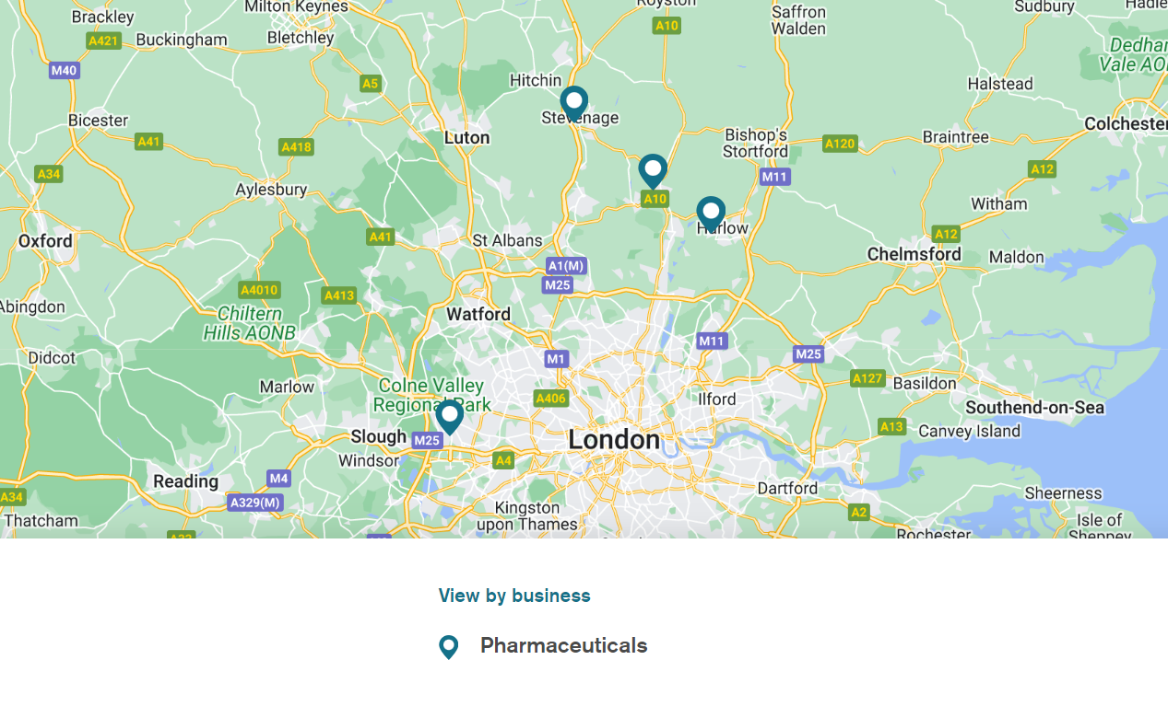
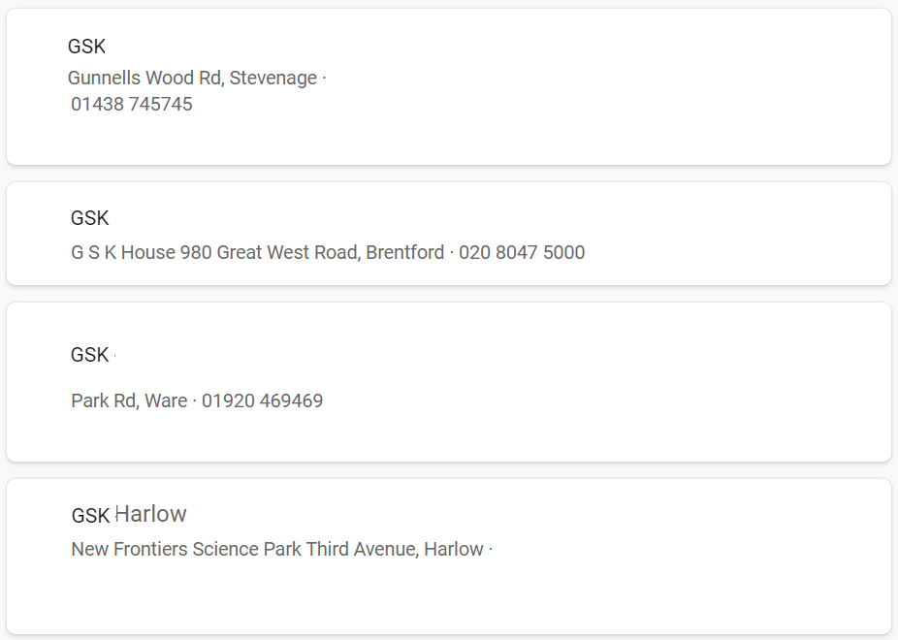
Where are our UK Research & Development sites

Slide 11
Where are these UK R&D Jobs based
GSK House, 980 Great West Road, Brentford, TW8 9GS
GSK Stevenage site, Medicines Research Centre,
Gunnels Wood Road, Stevenage, SG1 2NY
Working from home

